Slide 1
Detecting Diabetic Retinopathy
Abhishek Najbile
Kerry Mui
Yidan Zhu
Shibo Liu

Slide 2
Overview
Diabetic complication that affects the eyes
Caused by damage to the blood vessels of the light-sensitive tissue in the eye
Can be developed in anyone with type 1 or type 2 diabetes
Millions suffer from the disease and is the leading cause of blindness among working aged adults

Slide 3
Dataset and Problem Statement
The dataset is a part of the kaggle competition to detect Diabetic Retinopathy in eye images sponsored by Asia Pacific Tele-Opthalmology Society
The dataset contains 3662 images
Dataset url: https://www.kaggle.com/c/aptos2019-blindness-detection/data
How can Machine Learning help detect the severity of the disease so that doctors can asses and treat patients in a timely manner?

Slide 4

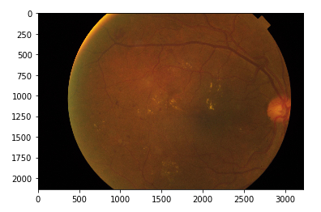
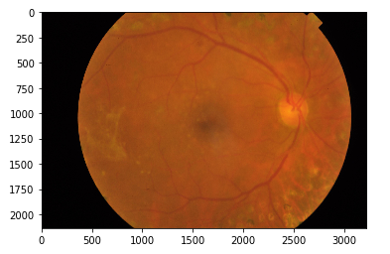
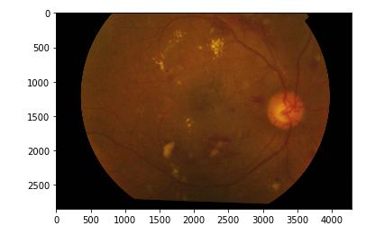
Exploring data
Different images from the dataset each with varying degrees of the disease progression

Slide 5
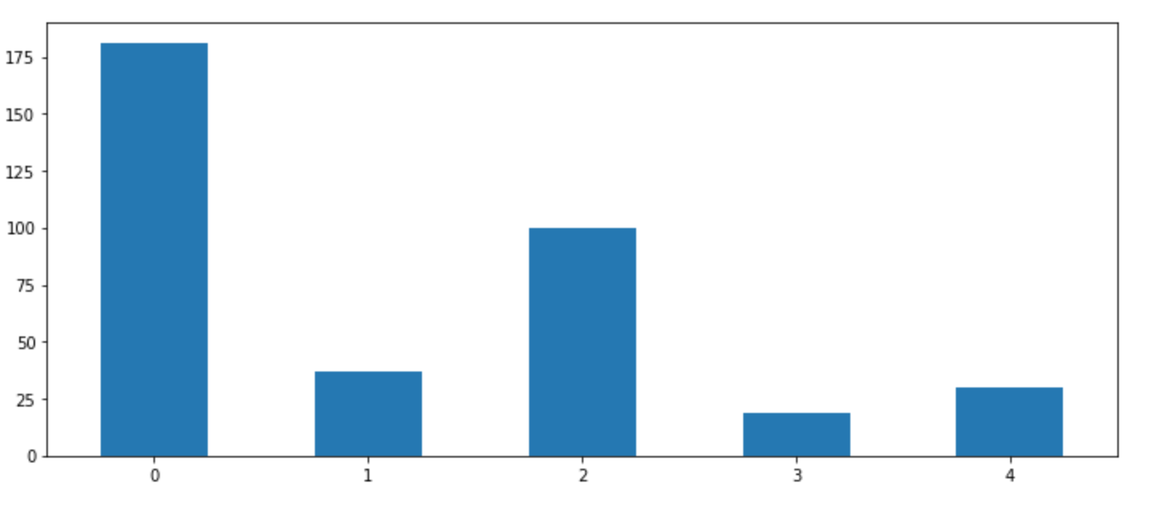
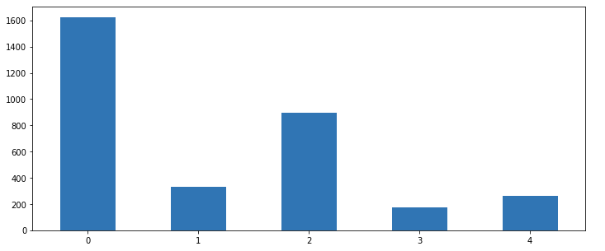
Distribution of labels
The labels are from the train and test dataset and we can see that it is very imbalanced
90% Train and 10% Test
25% is split into validation dataset from the train dataset
3295 images in train set and 367 images in test set
48.5% belongs to just one class, “0”

Slide 6
Architecture
Keras API for TensorFlow
Convolutional Neural Network
3 Conv2D layers each followed by MaxPooling2D layers and 2 Dense layers
Used Dropout, Learning Rate adjustment, L2 Regularization and Early Stopping to reduce overfitting
ImageDataGenerator used to generate batches of train ,validation and test data
Image augmentation

Slide 7

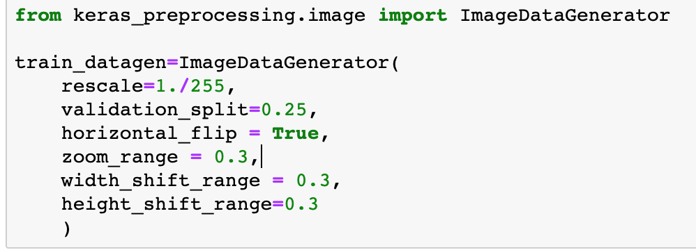
Image Augmentation
Image data augmentation is a great technique to artificially expand the size of the training dataset by creating modified versions of image in the dataset. This can greatly improve the ability of the model to generalize.

Slide 8
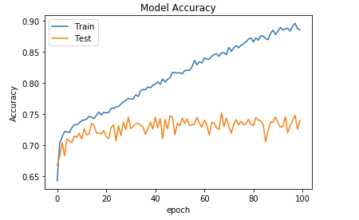
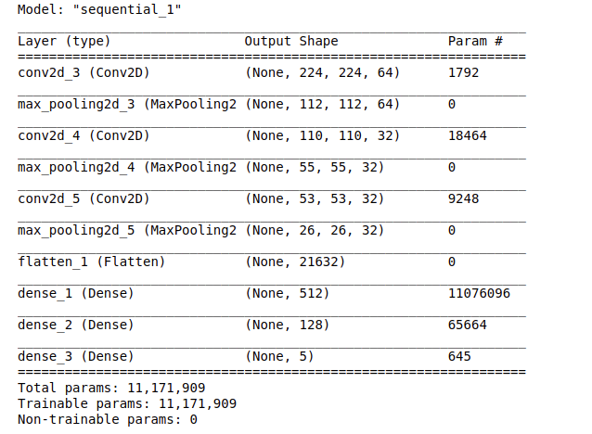
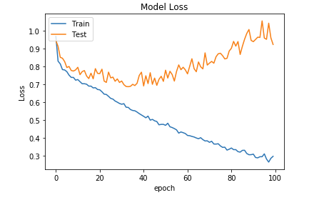
Baseline Model
Large Model with two Dense Layers of 512 and 128 nodes each and one Output layer. Takes ~13 hrs to run on GeForce RTX 2080Ti. Image size is around (224,224,3). Prone to overfitting.

Slide 9
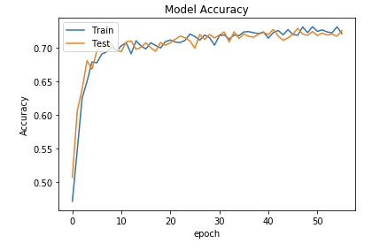
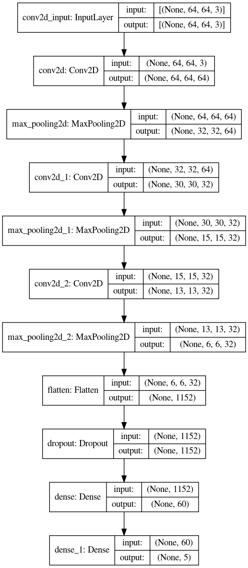
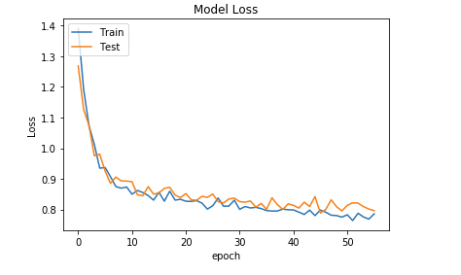
Regularized Model
Model has improved a lot. There is little to no overfitting but the accuracy has taken a hit. The validation and training loss is also very close to each other.
Early Stopping at epoch 54
Evaluation of the test set.
Loss: 0.801
Accuracy: 71%

Slide 10
Conclusions
Image classification can be computationally expensive
Image augmentation and regularization techniques such as L1 regularization, Early Stopping and adjusting the Learning Rate greatly reduces overfitting
Larger models tend to become memory banks that can memorize the training data but cannot generalize well
Smaller models and image sizes help with reduce overfitting

Slide 11
Recommendations and Next Steps
Use custom callbacks to better evaluate model. The competition uses Quadratic Weighted Kappa score to evaluate.
Consider transfer learning to take advantage of a bigger model that is trained on large number of images
Use cross validation and hyperparameter tuning techniques hardware permitting

Slide 12
Github

